Slide 1
Simulated annealing
Exploration and exploitation

Slide 2
Explore and exploit
Good move – high chance (or p=1)
Bad move – low chance
Temperature – control how likely we are to choose a bad node
High temperature => exploration
Low temperature => exploitation

Slide 3
Evaluating nodes
c <= current node
n <= next node
eval(x) <= evaluation function
ΔE <= how good the transition is
ΔE = eval(n) - eval(c)
(or flip signs if minimizing)

Slide 4
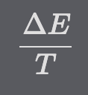
Parameters
Annealing is controlled by 2 parameters
ΔE or how good the move n is
T (Temperature) determines how much we care about ΔE
Influences the probability of taking the action n

Slide 5
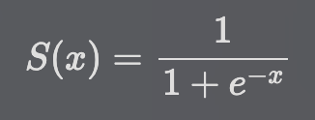
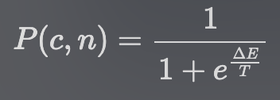
sigmoid
Need to assign probability (0-1) to a real input depending on its value
Low probability to negative inputs (bad moves)
High probability to positive inputs (good moves)
Many functions that can do that. Original paper exp(-ΔE/T)
Example function – sigmoid
Combine 2 ideas to get acceptance probability function

Slide 6
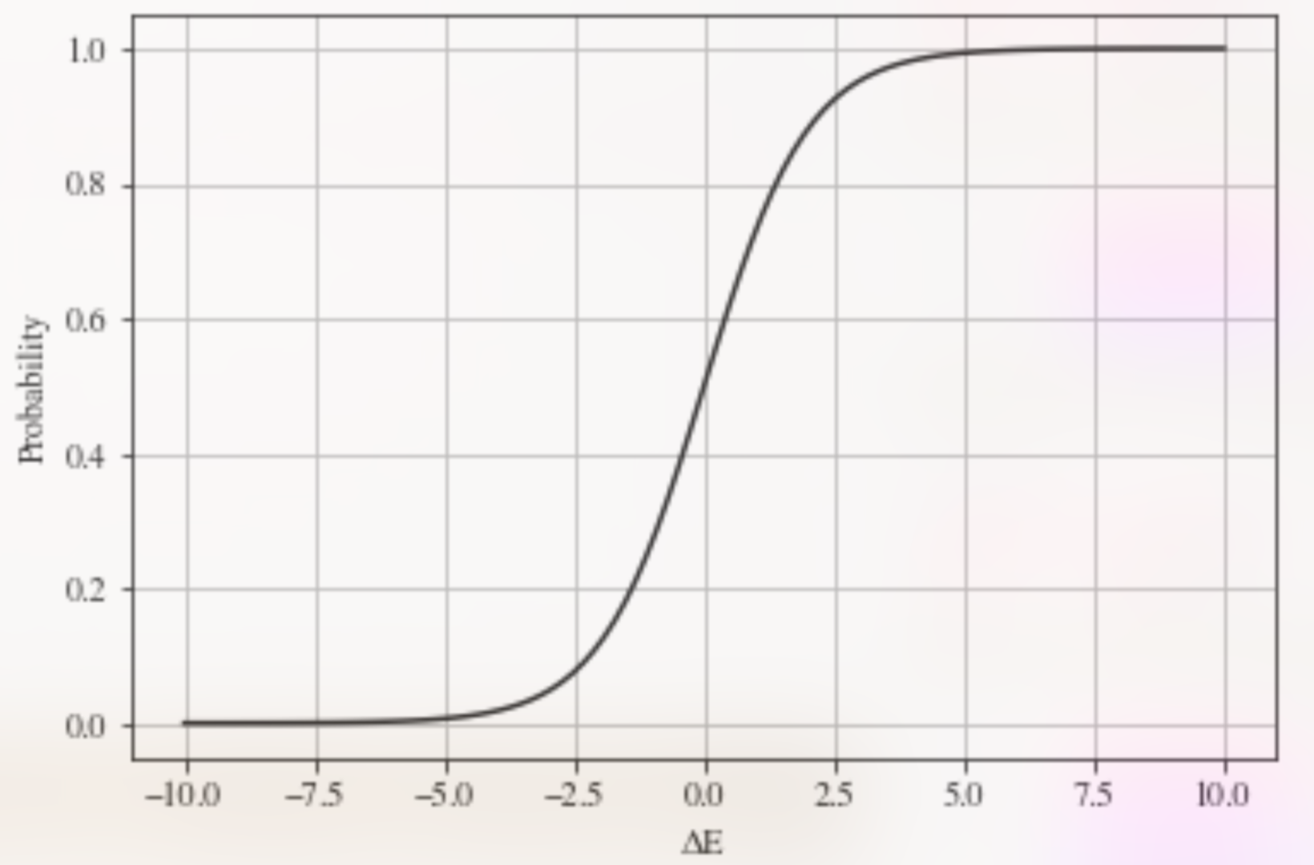
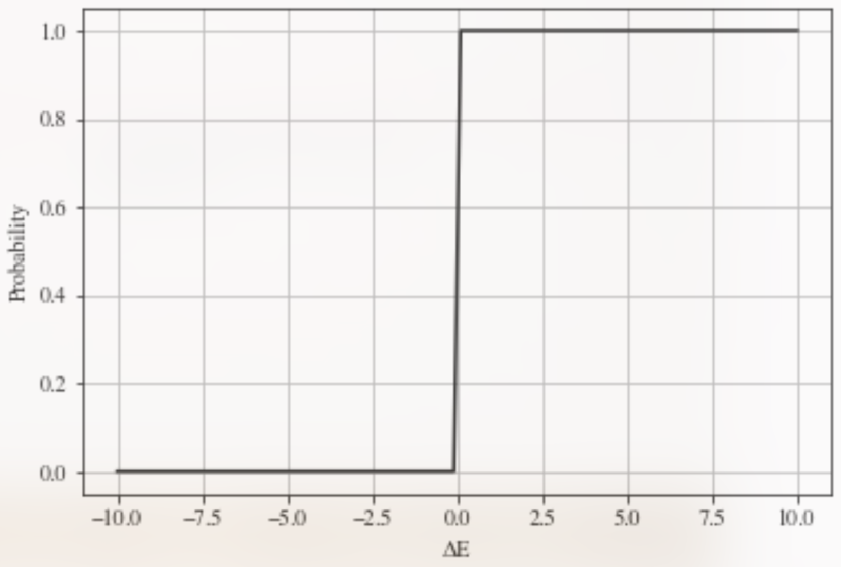
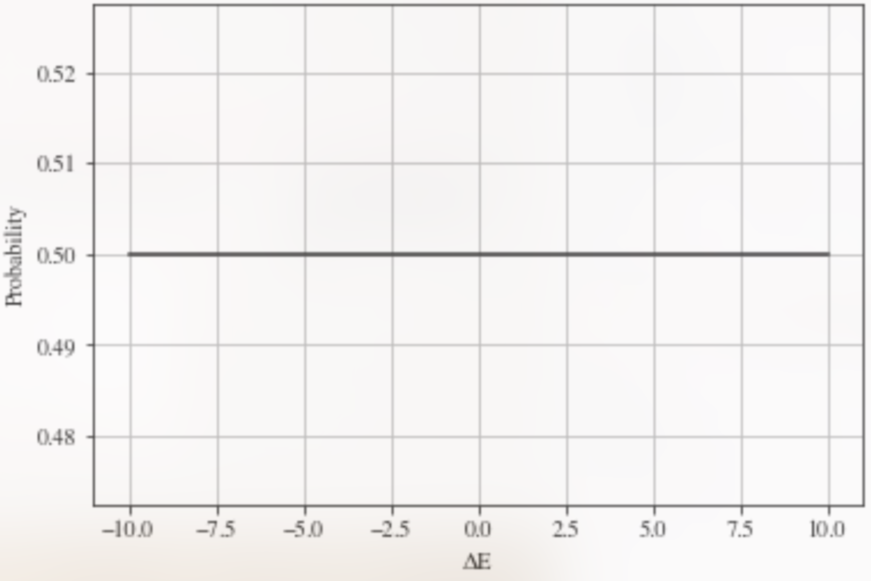
Acceptance probability curves
Acceptance probability curve for T=1
In ill climbing we make action only when ΔE > 0
In random walk, we have the same probability when taking any action (0.5)

Slide 7
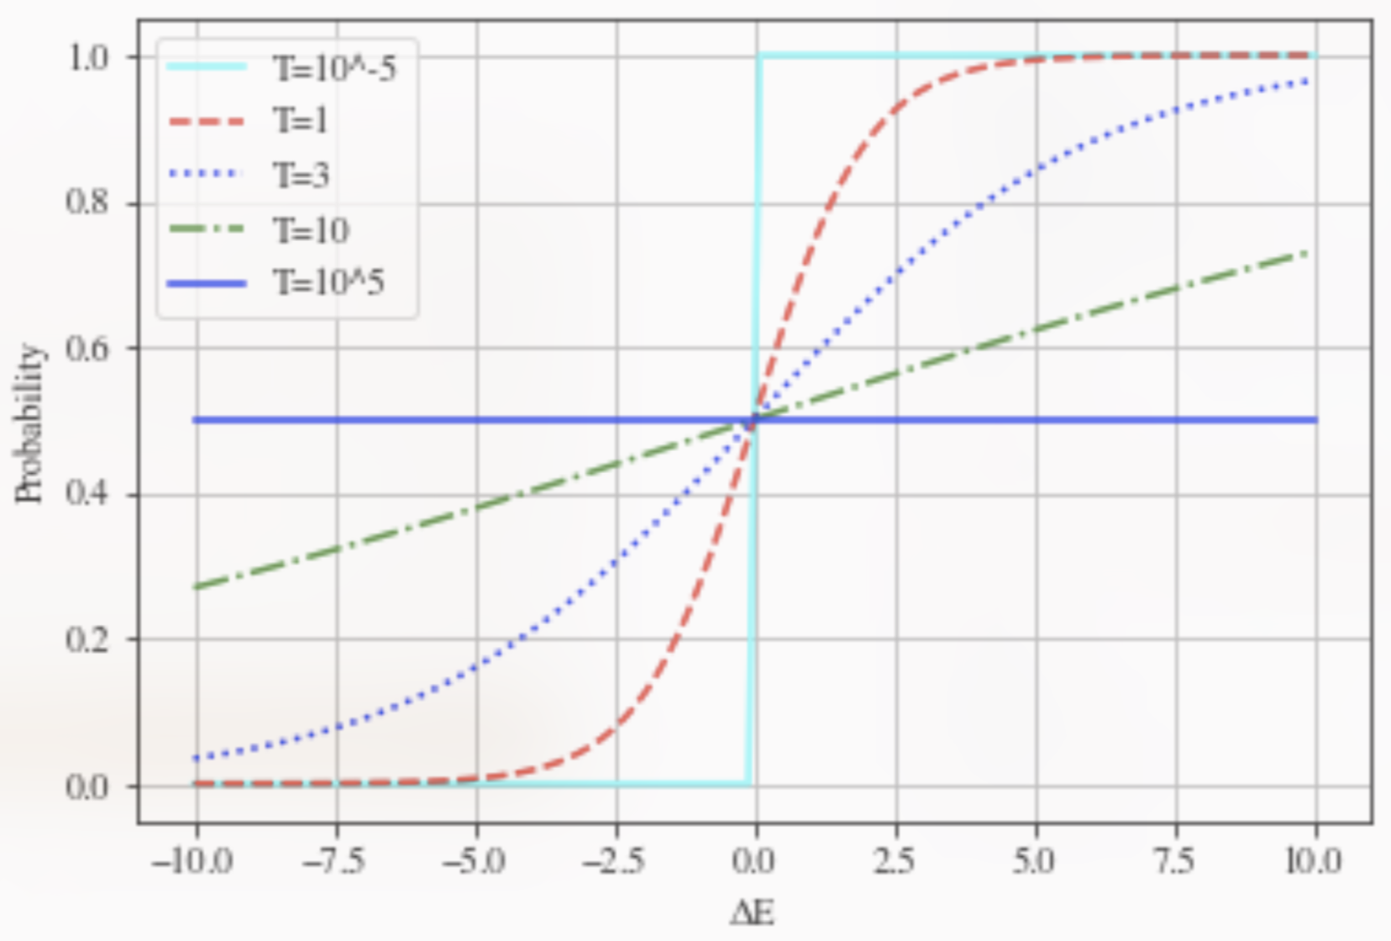
Changing Temperature
Let's play with Temperature and see how it affects the probability curve
The lower the Temperature, the more the graph looks like Hill Climbing.
The higher the temperature, the more the graph looks like Random Walk
Explore => increase T
Exploit => decrease T
Property is nicely demonstrated when we use a sigmoid acceptance probability function

Slide 8
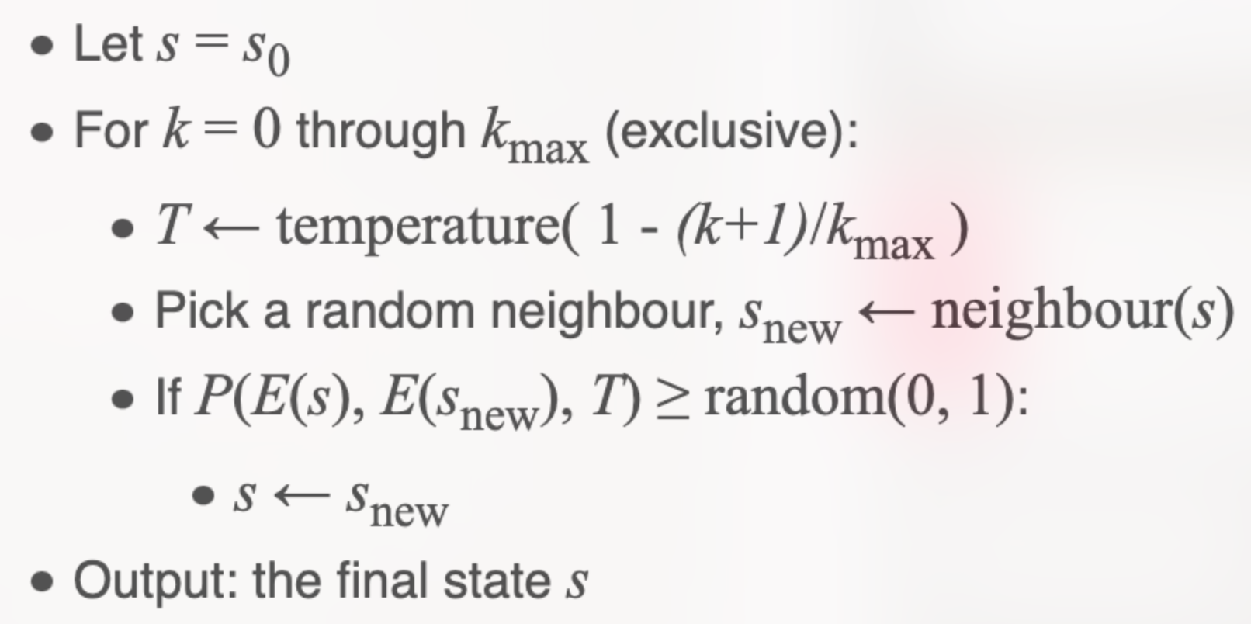
pseudocode

Slide 9
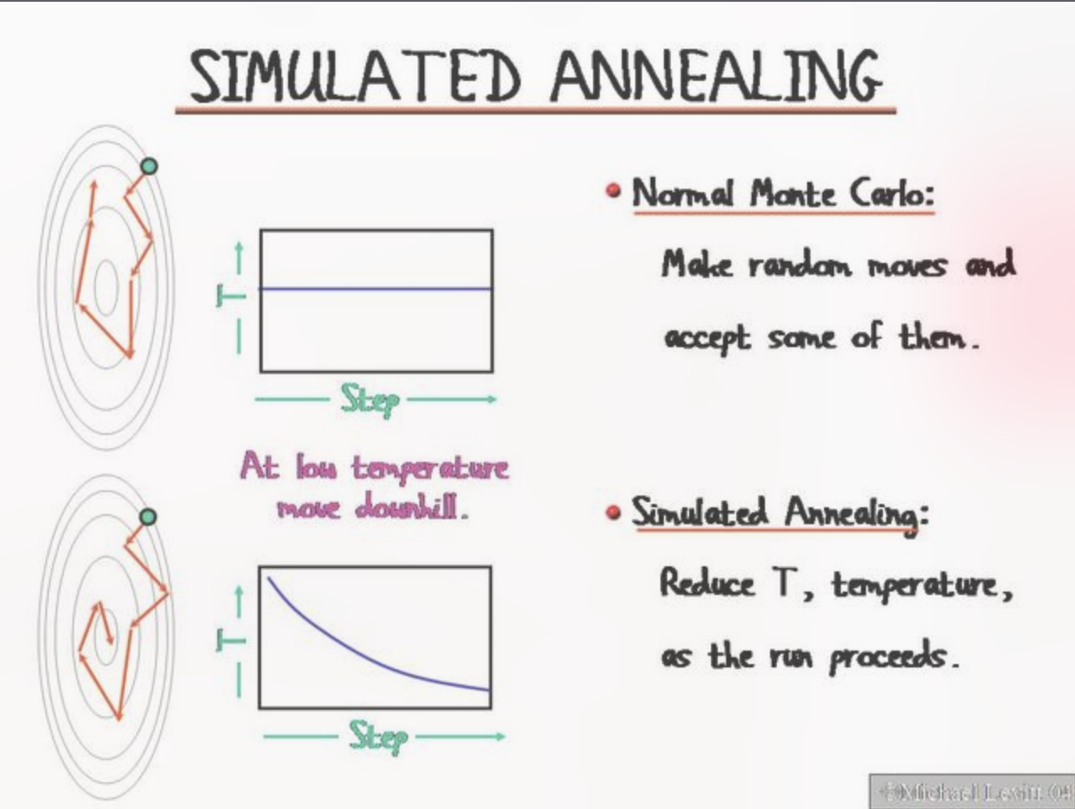
Markov chain monte carlo
Similar to Markov Chain Monte Carlo
Use only knowledge about the previous node to choose a new node
Decide whether to take a proposed move or not based on a random number

Slide 10
Metropolis
SA was inspired by Metropolis random walk algorithm
MCMC sampling method
Metropolis-Hastings algorithm
In both SA and M-H we explore a surface stochastically, using the Metropolis acceptance criterion for proposed points

Slide 11
Annealing (material science)
Inspired by real annealing process
Atoms migrate in the crystal lattice and the number of dislocations decreases, leading to a change in ductility and hardness.
Cooling the material in a controlled way
Properties that we want
Physical optimization (cool slowly -> less dislocations in crystal lattice -> material is hard and elastic).

